Slide 1
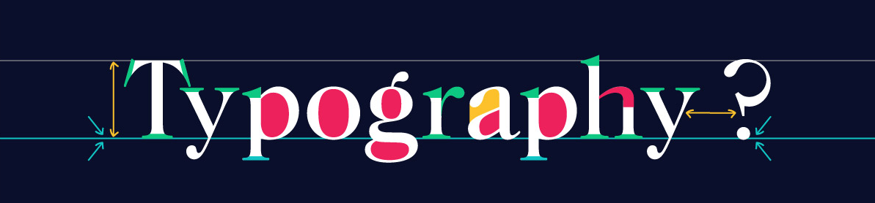
CSS & TYPOGRAPHY
SoftUni Team
Technical Trainers
Software University
https://softuni.bg

Slide 2
Table of Contents
Typography
Principles Of Readability
CSS Properties
Font Awesome Icons

Slide 3
Have a Question?
sli.do
#HTML-CSS

Slide 4
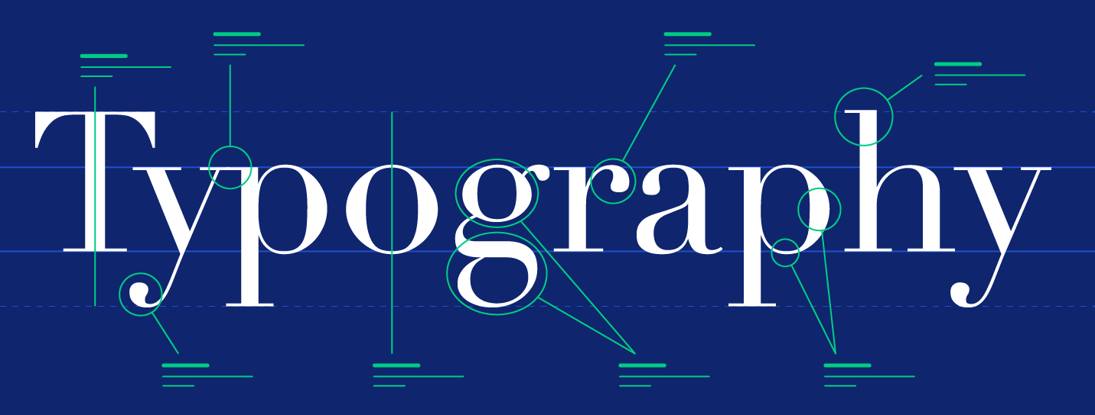
Typography

Slide 5
What is Typography?
Typography is the art and technique of arranging type to make written language legible, readable and appealing when displayed
Typography is the visual component of the written word
Style or appearance of text
The art of working with text

Slide 6
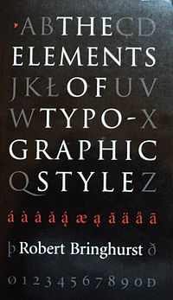

Books
The Elements of Typographic Style – the authoritative book on typography and style
The Elements of Typographic Style Applied to the Web – a practical guide to web typography

Slide 7
Principles Of Readability
Readability is one of the more important aspects of Web design usability
Website readability is a measure of how easy it is for visitors to read and understand online text
Readability depends on both a text’s presentation and its context
Poor readability scares readers away from the content

Slide 8
Principles Of Readability
Hierarchy – defines how to read through content
Contrast – the core factor in whether or not text is easy to read
Line Height – the space between individual lines of text
Letter Spacing – the space between each letter in words
Line Length – the number of words per line

Slide 9
Keys to Readable Typography
User-Friendly Headers
Scannable Text
White Space
Consistency
Density of Text
Emphasis of Important Elements
Organization of Information
Good Margins

Slide 10

CSS Properties

Slide 11
Font Family
The font-family property specifies the font for an element
Each font-family property lists one or more font families, separated by commas
If the browser does not support the first font, it tries the next font
body {
font-family: <family-name>, <generic-name>;
}
body {
font-family: Ariel, Helvetica, sans-serif;
}

Slide 12
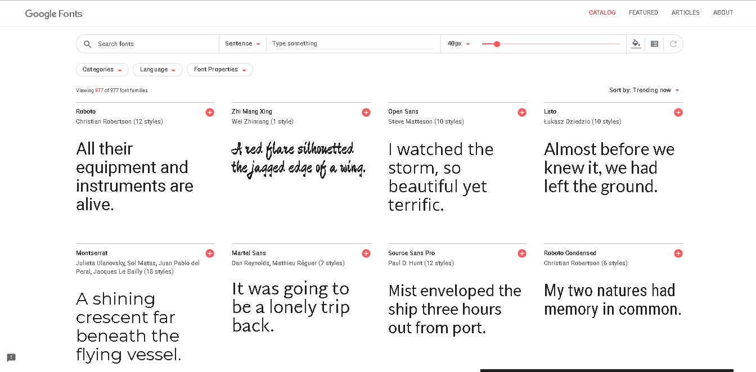
Family Name
<family-name> – the name of a font-family, like "Times" and "Helvetica"
If a font name contains white-space, it must be quoted
https://fonts.google.com/

Slide 13
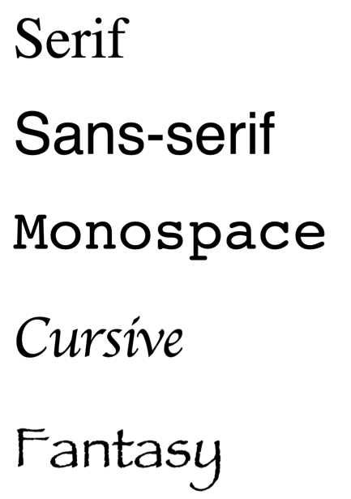
Generic Name
<generic-name> - a broad class of similar fonts used in a prioritized list of fonts
serif – all characters have stroke endings
sans-serif – no character has stroke endings
monospace – all characters have the same width
cursive – handwritten fonts
fantasy – decorative fonts

Slide 14
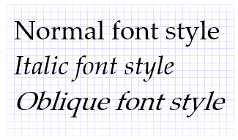
Font Style
Font-style – defines how much the text is slanted
normal – the text is not slanted
italic – the letters are slightly slanted
оblique – the letters are more slanted than italic
p {
font-style: normal;
}
p {
font-style: italic;
}
p {
font-style: oblique;
}

Slide 15
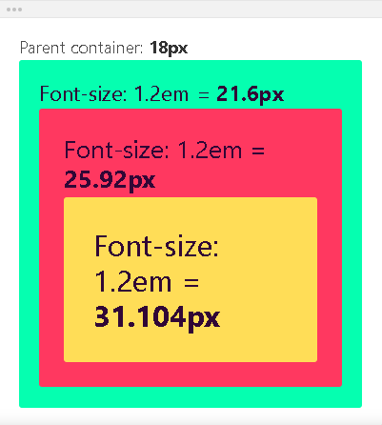
Font Size
Font-size – defines the text size
Pixel values
Em values – the value is relative to the parent’s font-size
p {
font-size: 16px;
}
p {
font-size: 1.2em;
}

Slide 16
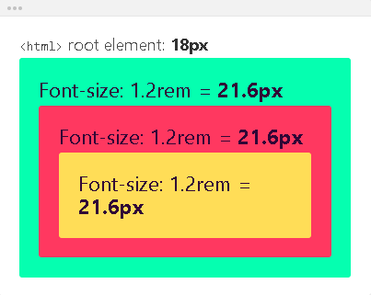
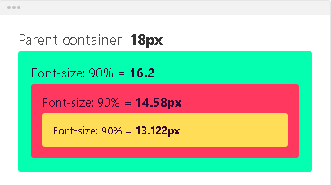
Font Size
Rem values – the value is relative to the root element’s font-size, which is the <html> element
Percentage values – they act like em values
p {
font-size: 1.2rem;
}
p {
font-size: 90%;
}

Slide 17


Font Weight
Font-weight – defines the weight of the text
normal – the text is in normal weight
bold – the text becomes bold
p {
font-weight: normal;
}
p {
font-weight: bold;
}

Slide 18
Font Weight
numeric values
They all correspond to a particular named weight:
100 – Thin 600 – Semi Bold
200 – Extra Light 700 - Bold
300 – Light 800 – Extra Bold
400 – Normal 900 – Ultra Bold
500 – Medium
p {
font-weight: 500;
}

Slide 19
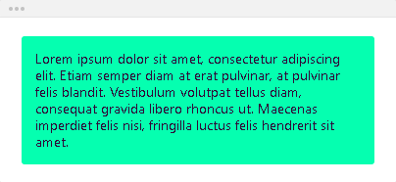
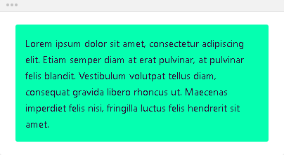
Line Height
Line-height – defines the height of a single line of text
Default value – reverts to the default value of the browser
Unitless values – the line height will be relative to the font size
p {
line-height: normal;
}
p {
line-height: 1.6;
}

Slide 20



Letter Spacing
Letter-spacing – defines the spacing between the characters of a block of text
Normal – the spacing between the characters is normal
Using pixel or em values
p {
letter-spacing: normal;
}
p {
letter-spacing: 2px;
}
p {
letter-spacing: 0.1em;
}

Slide 21
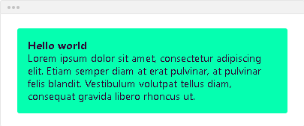
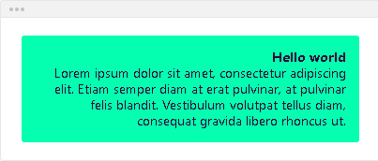
Text align
Text-align – defines how the content of the element is horizontally aligned
Left
Right
p {
text-align: left;
}
p {
text-align: right;
}

Slide 22
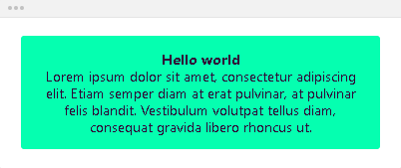
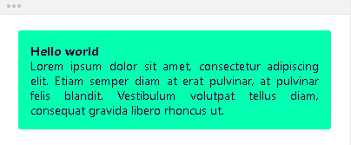
Text align
Center
Justify
p {
text-align: center;
}
p {
text-align: justify;
}

Slide 23


Text decoration
Text-decoration – defines how the text content of the element is decorated
None – removes any text decoration
Underline – underlines the text content
p {
text-decoration: none;
}
p {
text-decoration: underline;
}

Slide 24
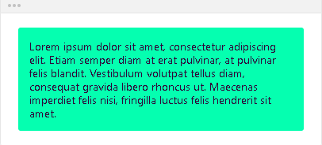
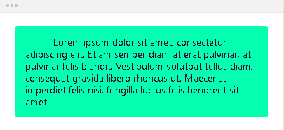
Text indent
Text-indent – defines the indentation of the element’s first line of text
The text is not indented
The text is indented
p {
text-indent: 0;
}
p {
text-indent: 40px;
}

Slide 25
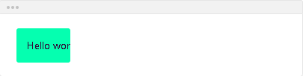
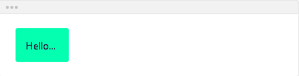
Text overflow
Text-overflow – defines how the hidden text content behaves if it’s overflowing
Clip – the text content is clipped and not accessible
Ellipsis – the overflowing content is replaced by …
p {
text-overflow: clip;
}
p {
text-overflow: ellipsis;
}

Slide 26
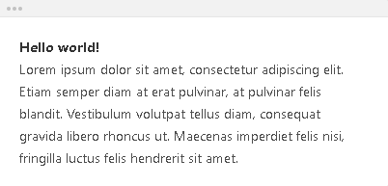
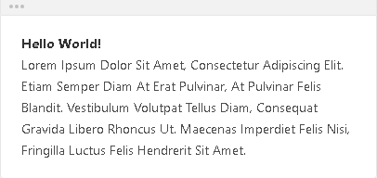
Text transform
Text-transform – defines how the text content should be transformed
None – default value
Capitalize – turns the first letter of each word into a capital letter
p {
text-transform: none;
}
p {
text-transform: capitalize;
}

Slide 27
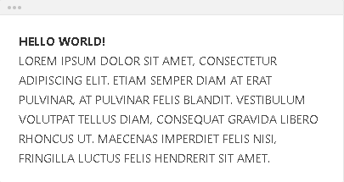
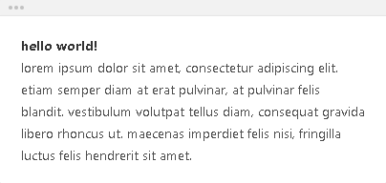
Text transform
Uppercase – turns all letters into capital letters
Lowercase – turns all letters into lowercase latters
p {
text-transform: uppercase;
}
p {
text-transform: capitalize;
}

Slide 28


Word break
Word break – defines how words should break when reaching the end of line
Normal – words with no space will not break
Break-all – words with no space will break as soon as they reach the end of a line
p {
word-break: normal;
}
p {
word-break: break-all;
}

Slide 29
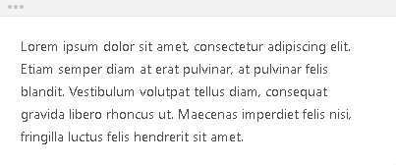
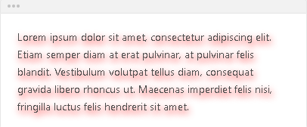
Text shadow
Text-shadow – defines the shadow of the text content
None – the text content has no shadow
Text-shadow: <horizontal> <vertical> <blur> <color>
p {
text-shadow: none;
}
p {
text-shadow: 2px 4px 10px red;
}

Slide 30


Text color
Color – defines the color of the text
Transparent
You can use one of the 140+ color names
p {
color: transparent;
}
p {
color: red;
}

Slide 31



Text color
You can use hexadecimal color codes
You can use rgb() color codes
You can use rgba() color codes
p {
color: #05ffb0;
}
p {
color: rgb(50, 115, 220);
}
p {
color: rgb(0, 0, 0, 0.5);
}

Slide 32


Background color
Background-color – defines the color of the element’s background
Transparent
Color
p {
background-color: transparent;
}
p {
background-color: red;
}

Slide 33


Cursor
Cursor – Sets the mouse cursor when hovering the element
Pointer
Move
p {
cursor: pointer
}
p {
cursor: move;
}

Slide 34

Outline
Outline
Outline-width - defines the width of the element's outlines
Outline-style - defines the style of the element's outlines
Outline-color - defines the color of the element's outlines
p {
outline: 4px dotted red;
}

Slide 35
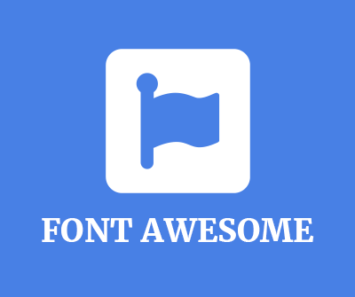
Icons
Font Awesome

Slide 36
Form Awesome
To use the Font Awesome icons, add the following line inside the <head> section of your HTML file:
Import Font Awesome in the css file:
Font Awesome is designed to be used with inline elements. The <i> and <span> elements are widely used for icons
<link rel="stylesheet" href="https://use.fontawesome.com/releases/v5.12.1/css/all.css">
@import 'https://use.fontawesome.com/releases/v5.12.1/css/all.css';

Slide 37
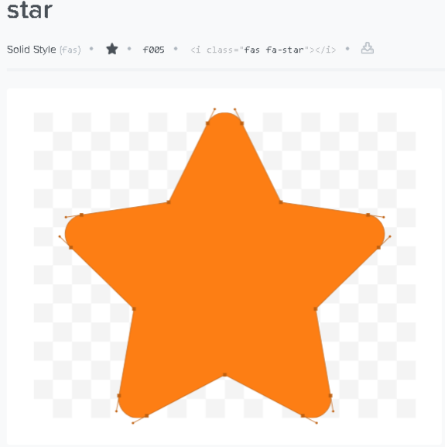
Font Awesome Example
Choose an icon
Copy the <i> element
Paste it in your HTML file
<!DOCTYPE html>
<html>
<head>
<link rel="stylesheet" href="https://use.fontawesome.com/releases/v5.12.1/css/all.css">
</head>
<body>
<i class="fas fa-star"></i>
</body>
</html>

Slide 38

Summary
What is Typography?
The principles of readability
CSS properties: font-family, font-size, font-style, color, background
Font Awesome Icons
…
…
…

Slide 39












SoftUni Diamond Partners

Slide 40




SoftUni Organizational Partners

Slide 41
Questions?
Notes:
41

Slide 42

License
This course (slides, examples, demos, exercises, homework, documents, videos and other assets) is copyrighted content
Unauthorized copy, reproduction or use is illegal
© SoftUni – https://softuni.org
© Software University – https://softuni.bg
Notes:
42

Slide 43
Trainings @ Software University (SoftUni)
Software University – High-Quality Education, Profession and Job for Software Developers
softuni.bg, softuni.org
Software University Foundation
softuni.foundation
Software University @ Facebook
facebook.com/SoftwareUniversity
Software University Forums
forum.softuni.bg
Notes:
43

